Slide 1
Introduction to Linear Regression
First Move towards Data Analytics
Business Statistics: A Decision-Making Approach, 7e © 2008 Prentice-Hall, Inc.
Chap 14-<number>

Slide 2
Introduction to
Regression Analysis
Regression analysis is used to:
  Predict the value of a dependent variable based on the value of at least one independent variable
  Explain the impact of changes in an independent variable on the dependent variable
Dependent variable: the variable we wish to explain
Independent variable: the variable used to explain the dependent variable
Business Statistics: A Decision-Making Approach, 7e © 2008 Prentice-Hall, Inc.
Chap 14-<number>

Slide 3
Simple Linear Regression Model
Only one independent variable, x
Relationship between x and y is described by a linear function
Changes in y are assumed to be caused by changes in x
Business Statistics: A Decision-Making Approach, 7e © 2008 Prentice-Hall, Inc.
Chap 14-<number>

Slide 4
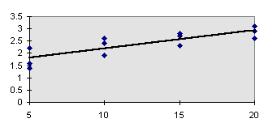
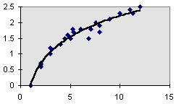
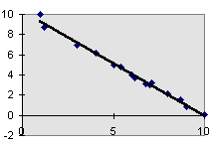
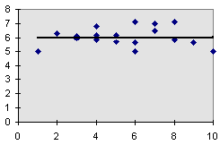
Types of Regression Models
Positive Linear Relationship
Relationship NOT Linear
Negative Linear Relationship
No Relationship
Business Statistics: A Decision-Making Approach, 7e © 2008 Prentice-Hall, Inc.
Chap 14-<number>

Slide 5
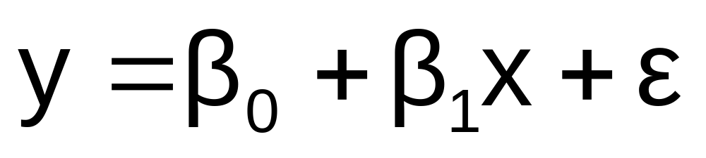
Population Linear Regression
The population regression model:
Population Slope
Coefficient
Random Error term, or residual
Population
y intercept
Independent Variable
Dependent Variable
Linear component
Random Error
component
Business Statistics: A Decision-Making Approach, 7e © 2008 Prentice-Hall, Inc.
Chap 14-<number>

Slide 6
Linear Regression Assumptions
Error values (ε) are statistically independent
Error values are normally distributed for any given value of x
The probability distribution of the errors is normal
The distributions of possible ε values have equal variances for all values of x
The underlying relationship between the x variable and the y variable is linear
Business Statistics: A Decision-Making Approach, 7e © 2008 Prentice-Hall, Inc.
Chap 14-<number>

Slide 7
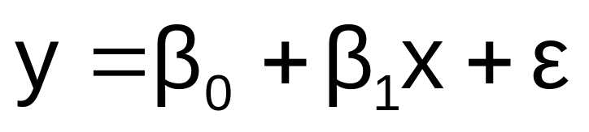
Population Linear Regression
(continued)
y
Observed Value of y for x_{i}
ε_{i}
Slope = β₁
Predicted Value of y for x_{i}
Random Error for this x value
Intercept = β₀
x_{i}
x
Business Statistics: A Decision-Making Approach, 7e © 2008 Prentice-Hall, Inc.
Chap 14-<number>

Slide 8
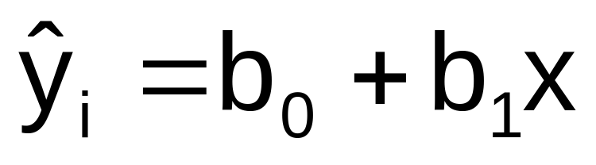
Estimated Regression Model
The sample regression line provides an estimate of the population regression line
Estimated (or predicted) y value
Estimate of the regression
intercept
Estimate of the regression slope
Independent variable
The individual random error terms e_{i} have a mean of zero
Business Statistics: A Decision-Making Approach, 7e © 2008 Prentice-Hall, Inc.
Chap 14-<number>

Slide 9
Interpretation of the
Slope and the Intercept
b₀ is the estimated average value of y when the value of x is zero
b₁ is the estimated change in the average value of y as a result of a one-unit change in x
Business Statistics: A Decision-Making Approach, 7e © 2008 Prentice-Hall, Inc.
Chap 14-<number>

Slide 10
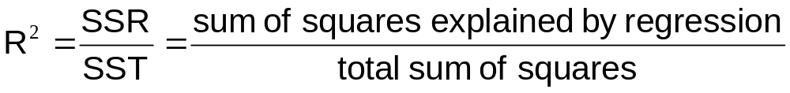

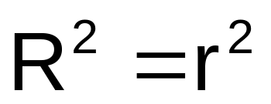
Coefficient of Determination, R²
The coefficient of determination is the portion of the total variation in the dependent variable that is explained by variation in the independent variable
where
Note: In the single independent variable case, the coefficient of determination is
where:
R² = Coefficient of determination
r = Simple correlation coefficient
Business Statistics: A Decision-Making Approach, 7e © 2008 Prentice-Hall, Inc.
Chap 14-<number>

Slide 11
CASE STUDY
Stock Price Prediction
Business Statistics: A Decision-Making Approach, 7e © 2008 Prentice-Hall, Inc.
Chap 14-<number>

